Slide 1


Your Personal Safety Companion: Alertify
Project Title : Alertify - Smart Safety Web App
Your Name : Katapally Vivek
Roll No :249P1A6716
Department : CSD
College Name :Sree Dattha Group of Institutions
Team Status : Individual
Notes:
• Introduction to Alertify, a personal safety companion app. • Developed by Katapally Vivek from Sree Dattha Group of Institutions, Department of CSD. • Designed to enhance user safety through accessible emergency alerts and safety tips. • Focuses on user-friendly interface in a modern home setting.

Slide 2

CONTENTS
1. Introduction
2. Problem Statement
3. Objectives
4. Features
5. Technologies Used
6. Implementation
7. Future Enhancements
8. Conclusion

Slide 3
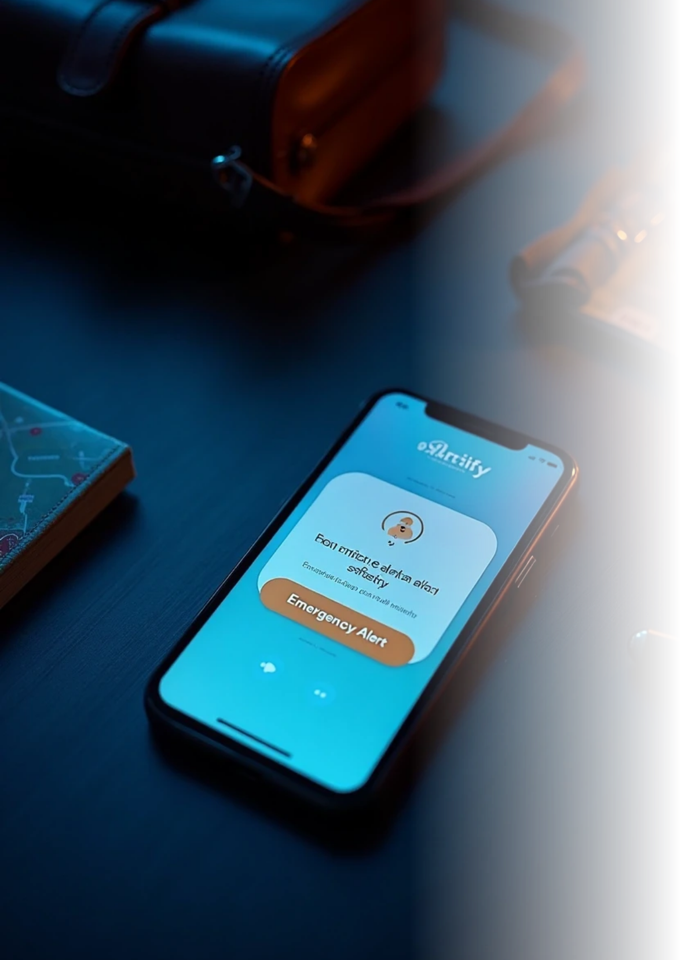
Introduction:
What is Alertify?
Alertify is a web-based safety application designed to protect users, especially women, while traveling alone.
It provides instant emergency alerts to trusted contacts with minimal effort.
Why it was developed
Many people face safety concerns when traveling alone at night. Existing solutions are slow, complicated, or unreliable.
Alertify was created to enable quick, reliable help in emergency situations.

Slide 4

2. Problem Statement
Real-World Issue Alertify Solves
Many individuals face safety risks while traveling alone, especially at night.
Delays in contacting help can lead to dangerous situations.
Existing solutions (manual calling, generic apps) are often slow, unreliable, or hard to use in emergencies.

Slide 5
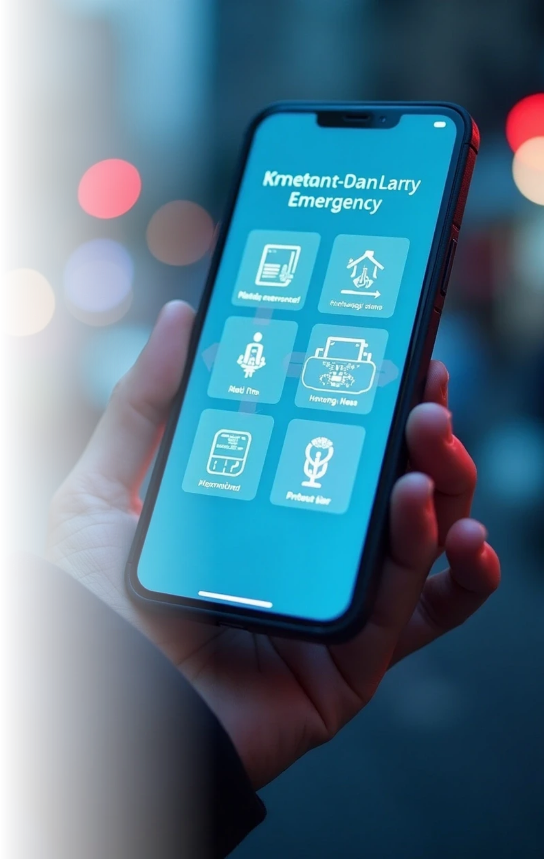



3. Objectives
Clear Goals of the Project
1
2
Instant Emergency Alerts
Real-Time Location Sharing
Enable users to notify trusted contacts immediately.
Share GPS coordinates during emergencies.
3
4
Easy-to-Use Interface
Reliability & Safety
Ensure quick access to the alert system.
Provide a system users can trust in critical situations.

Slide 6
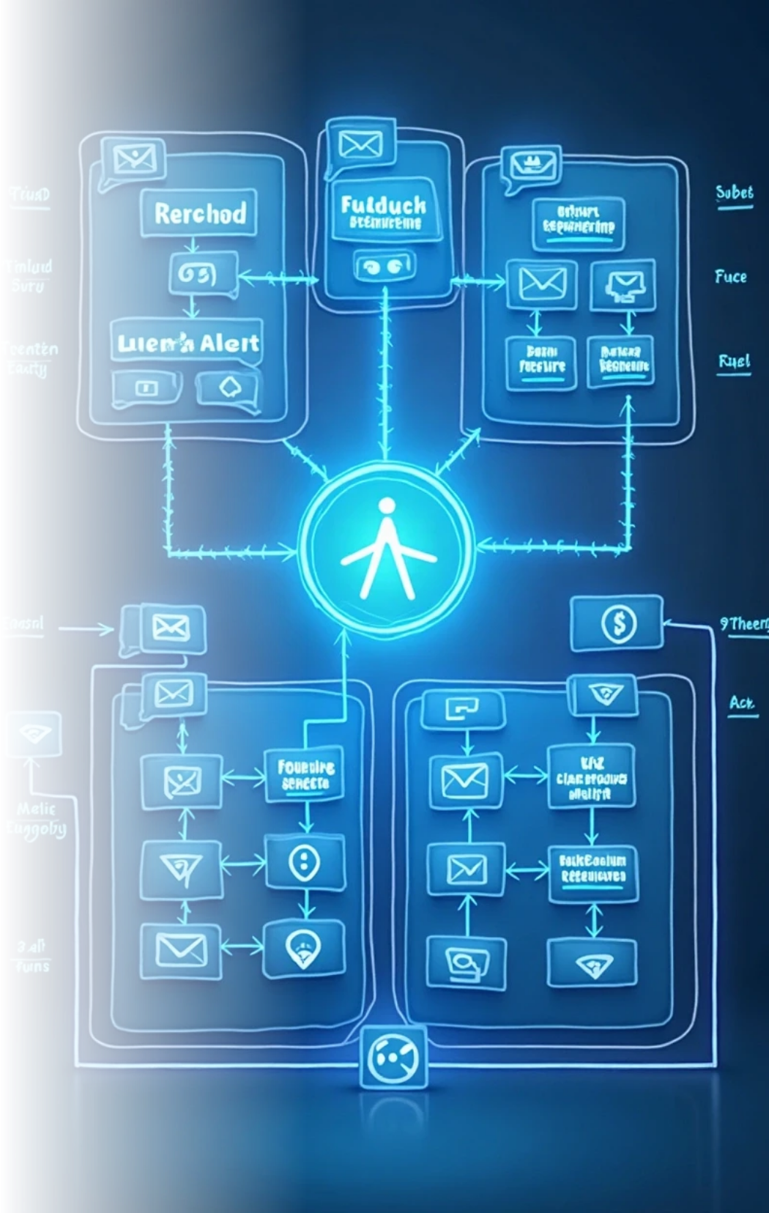


System Architecture / Flowchart
Flowchart Idea: User Feels Unsafe
Press Alertify Button
Capture Live Location (GPS)
Send Alert Message & Location to Trusted Contacts
Trusted Contact Receives Alert
Help is Sent
Architecture Diagram:
Tech Stack:
Frontend
APIs
React.js, HTML, CSS, JavaScript
Geolocation API, WhatsApp service
(Future Integration)
Modules
Email API for real-time alerts
Trusted Contacts, Alert System, Live Location Sharing

Slide 7
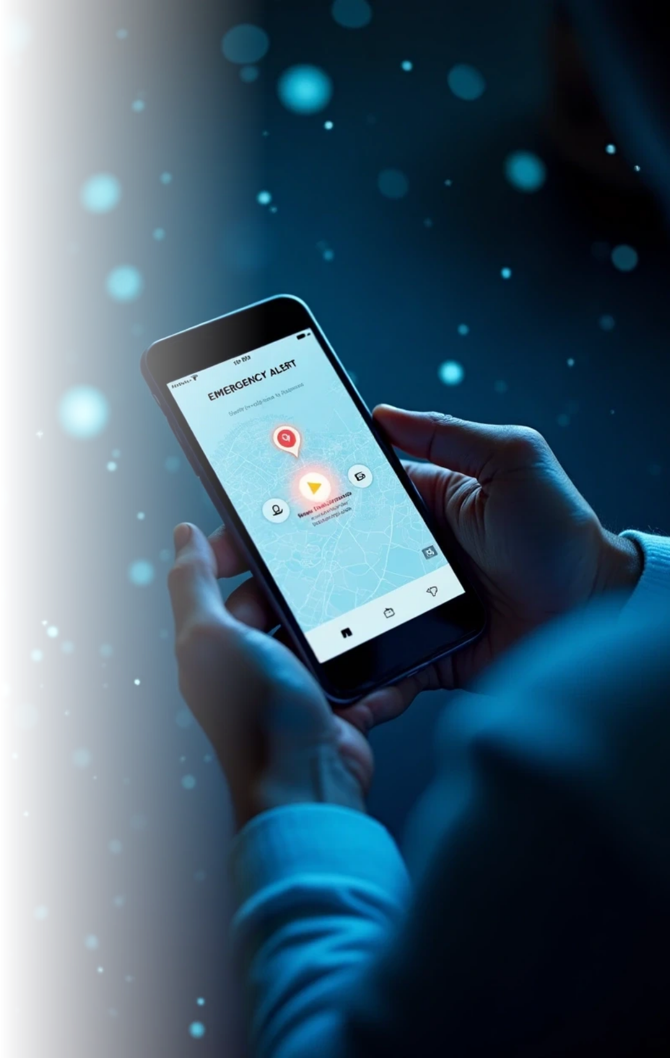



4. Features
1
2
One-Click Alert Button
Trusted Contacts
Sends instant emergency notification.
Users can register multiple contacts.
3
4
Live Location Sharing
WhatsApp Notifications
Real-time GPS location sent automatically.
Alert sent directly to contacts.

Slide 8


5. Technologies Used
Tech Stack
Frontend
React JS, HTML, CSS
Backend
Firebase (Authentication, Database, Cloud Messaging)
Tools
Google Maps API (for live location), WhatsApp API,Leaflet

Slide 9




6. Implementation
1
2
Modules
Screenshots/Diagrams
• Trusted Contacts Module: Add/remove contacts.
• Home Screen (Alert button)
• Alert Module: One-click emergency alert.
• Trusted Contacts Screen
• Live Location Module: Capture and send GPS location.
• Confirmation Alert Screen
• Notification Module: Sends WhatsApp alerts to contacts.

Slide 10


7. Future Enhancements
AI-based Threat Detection
SMS Alerts
In addition to email, send SMS notifications.
Predict risky areas or behavior.
SOS Calling Feature
Panic Mode Automation
Automatically call nearest help services.
Activate alerts if unusual inactivity is detected.

Slide 11
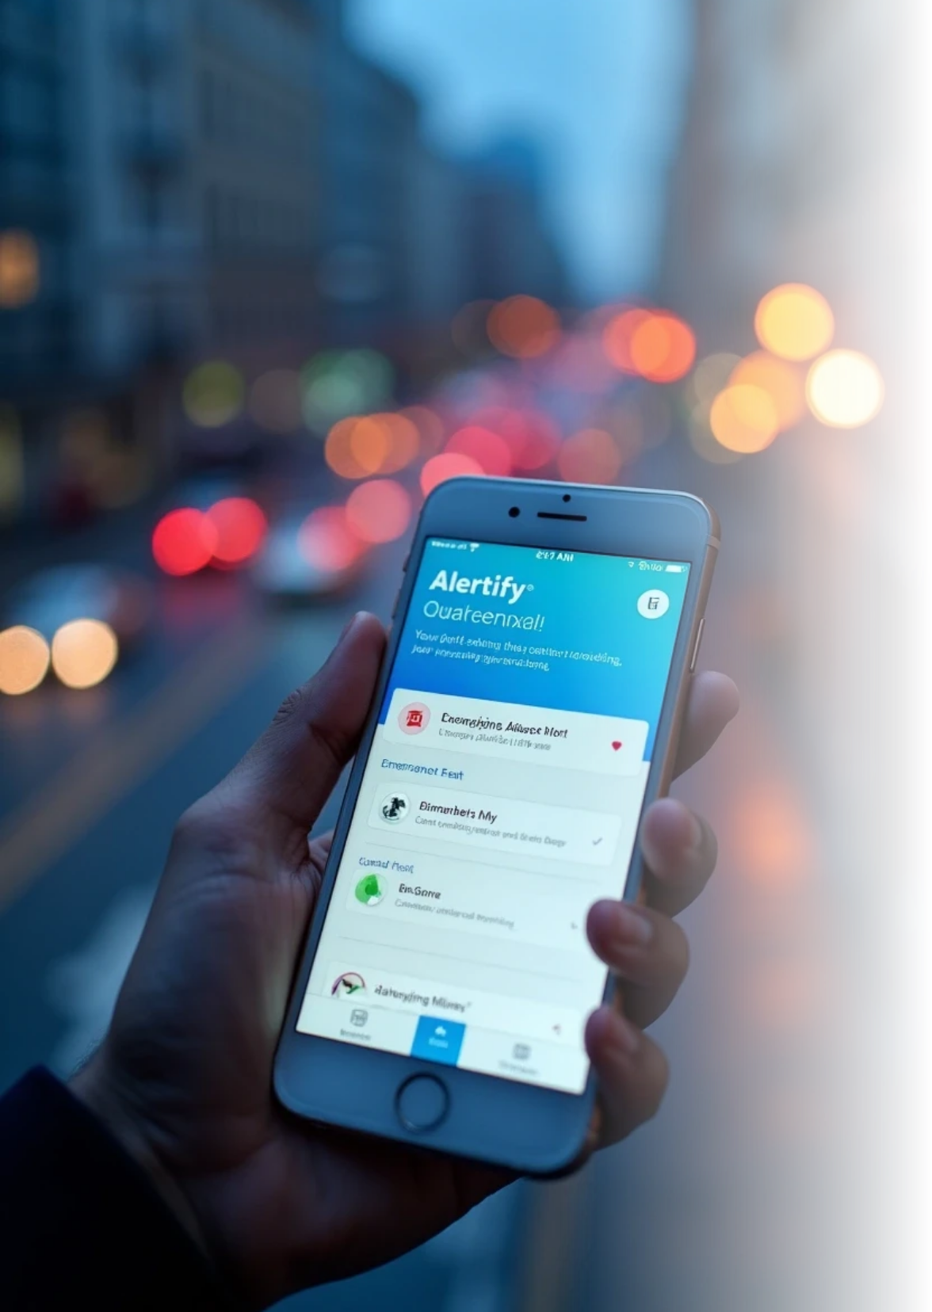
8. Conclusion
Alertify provides quick and reliable emergency alerts.
It improves personal safety for users traveling alone.
Successfully implements real-time location sharing and trusted contact alerts.
A scalable solution with potential future AI and automation enhancements.

Slide 12

Thank You

